Slide 1
Music recommendation system
Team Members:
Avi Jain <SJSU ID: 009425806>
Eshan Haval <SJSU ID: 009390875>
Jasleen Kaur <SJSU ID: 009430304>
Raghav Munjal <SJSU ID:008951605>
Sagar Ruchandani <SJSU ID: 009428731>
Shubham Rajvanshi <SJSU ID: 009428744>
Guided By:
Prof. Simon Shim

Slide 2
Agenda
Goal
Objectives
Data Set
Architecture
Tools
Flow
Screen Shots
Future Enhancements
Conclusion

Slide 3
Goal
Provide recommendations regarding Music, based on user inputs in Yahoo Web Scope C15 data set.

Slide 4
objectives
Analyze the Yahoo Web Scope C15 data set, to recommend the music to users.
Recommend its users upon its previous selection and recommend the song what he/she may listen.

Slide 5


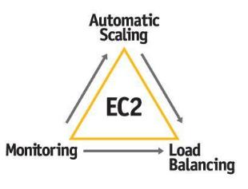





architecture

Slide 6
Algorithm Used: Log Likely Hood
Two users are similar when they rate or are associated to many of the same items. However, a certain overlap may or may not be meaningful -- it could be due to chance, or due to the fact that we have similar tastes.
For example if two persons have rated 100 items each, and 50 overlap, they are probably similar. But if they each rate 1000 and overlap in only 50, maybe they are not.
The log-likelihood metric is just trying to formally quantify how unlikely it is that our overlap is due to chance. The less likely, the more similar they are. So it is comparing two likelihoods, and just looking at their ratio
Two users are similar when they rate or are associated to many of the same items. However, a certain overlap may or may not be meaningful -- it could be due to chance, or due to the fact that we have similar tastes. For example if two persons have rated 100 items each, and 50 overlap, they are probably similar. But if they each rate 1000 and overlap in only 50, maybe they are not. The log-likelihood metric is just trying to formally quantify how unlikely it is that our overlap is due to chance. The less likely, the more similar they are. So it is comparing two likelihoods, and just looking at their ratio

Slide 7
Tools & TECHNOLOGIES
RESTful Web services
Groovy Server Pages
AWS RDS
AWS EC2
Apache Mahout
Apache Hadoop
Groovy & Grails tool suite

Slide 8
Flow
Application and AWS RDS
REST web service is integrated with RDS instance of MySQL on AWS. This API provides basic functionalities like user Register, login, Profile Management, search, review recommendations and logout.
HDFS to Mahout
Data set is stored in HDFS initially. Mahout provides a suite of machine learning libraries designed to be scalable and robust Data will be processed from Mahout to Apache Hadoop. Map reduce functionality is being executed with in Hadoop and the required analysis is obtained from using HDFS.
Groovy to RDS
Upon successful data analysis and results are stored back in HDFS from Mahout, an efficient groovy script collects these results and pushes it onto RDS instance on AWS. This is the main functionality of this API that provides and essential module in system.

Slide 9
Top N Recommendation
We have given a generic top n recommendation for every user who is new or old based on the all the data set we have.
We have calculated the top recommendation by following sub categories:
By Artist
By Album
By Genre
By Track
These all will result all top recommendation

Slide 10
Pre-Processing data
We write a java code to pre process the information of music recommendation data to meaningful data for music recommendation.
Removed all the null from the values.
Created the data into simpler form .
Push that data to the Mysql database.

Slide 11
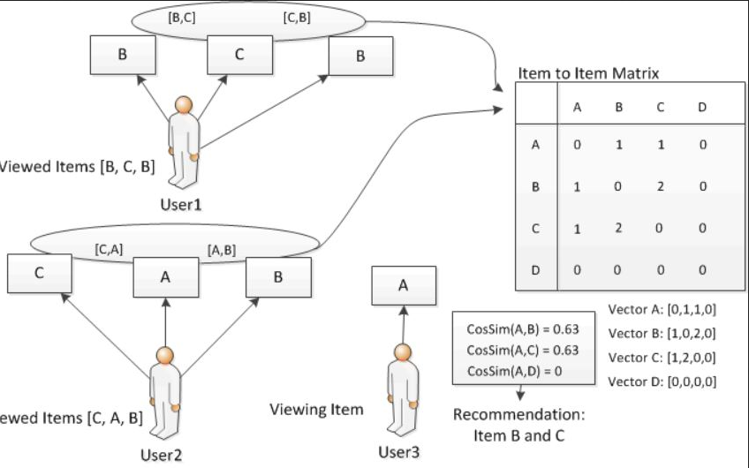
Component interaction diagram

Slide 12
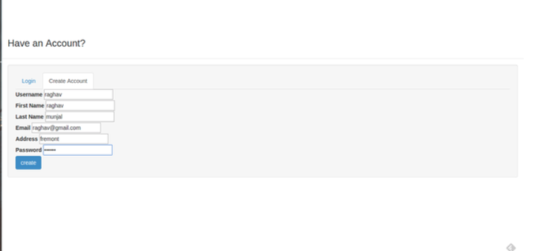
ScREEN Shots: Sign up

Slide 13
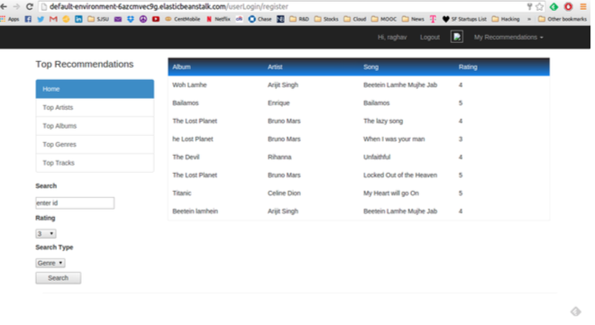
ScreenShot:INDEX Page

Slide 14
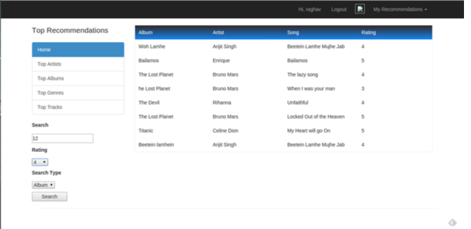
ScreenShot:Search ALBum

Slide 15
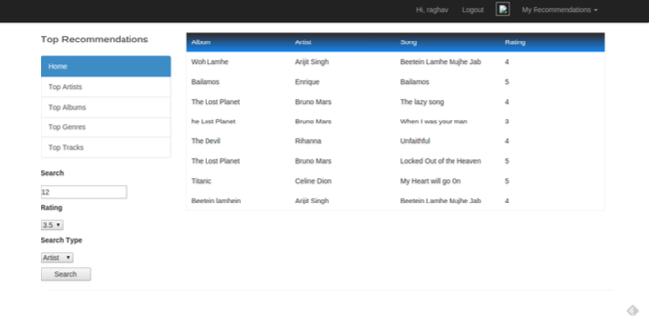
ScreenShot:Artist Search

Slide 16
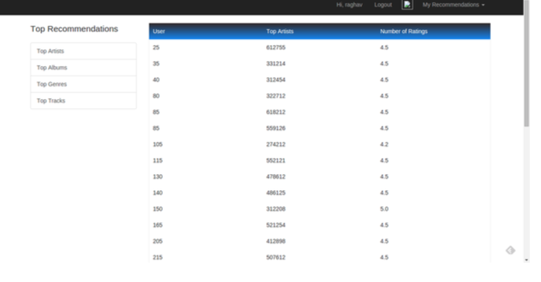
Screenshots:artist search result

Slide 17
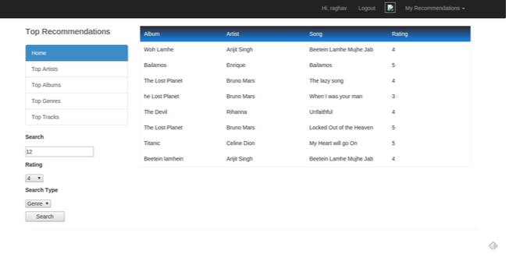
Screenshot:genre Search

Slide 18
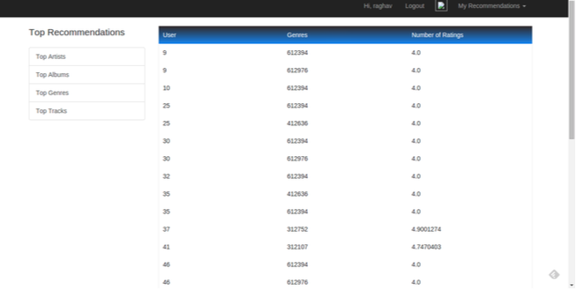
Screenshot:genre Search

Slide 19
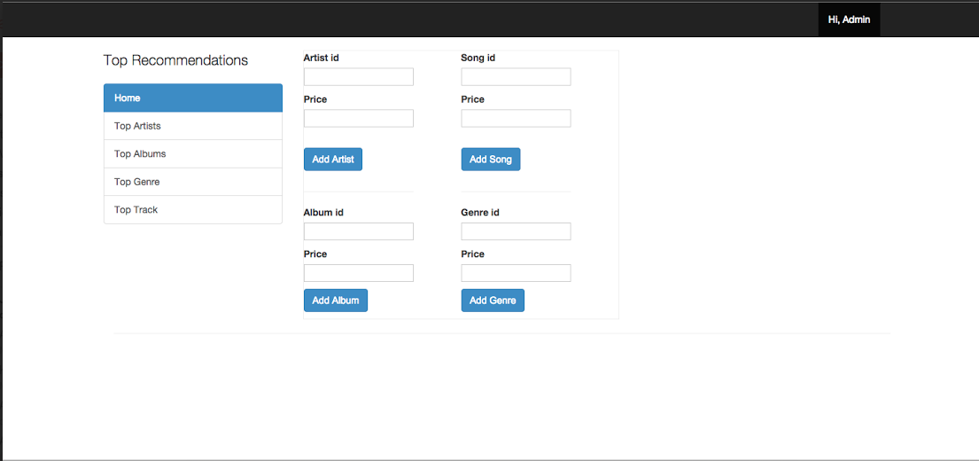
ScreenShot:Adding song

Slide 20
Future enhancements
Music recommendation application can be developed on different environments.
We can add more number of data sets and performance metrics and get more accurate results.
The application can be scaled to more number of hosts and for each host using quad core we can maximize number of threads that are collecting data from database.

Slide 21
Conclusion
Lesson learnt
Experience of system development with huge amount of data.
Got good exposure to major AWS services and integration.
Effective selection and use of RDS.
Difficulties faced:
Data Analysis: Size of the data was huge. More than 5GB data
Data transfer from Mahout to RDS.

Slide 22


REFERENCES
Data Set: http://webscope.sandbox.yahoo.com/catalog.php?datatype=c
Apache Mahout: http://mahout.apache.org/
Apache Hadoop: http://hadoop.apache.org/
Grails docs: https://grails.org/Documentation
AWS docs: http://aws.amazon.com/documentation/
Mahout in Action

Slide 23

THANK YOU!!!
THANK YOU!!!

